Slide 1
Logistic Regression part 1

Slide 2
Linear Classifier
A A A A A A
A A A A A A A A
A A A A A A
Z = w₁ x₁ + w₂ x₂ + b
Z = <w₁, w₂> <x₁, x₂> + b
= w.x + b
Where w = <w₁, w₂>
x = <x₁, x₂>
x2
B B B B B B B
B B B B B B
B B B B B
x1
If we insert x₁ and x₂ values for any object of class A, Z will be positive
If we insert x₁ and x₂ values for any object of class B, Z will be negative
We can say that if Z>0 class is A otherwise class is B

Slide 3
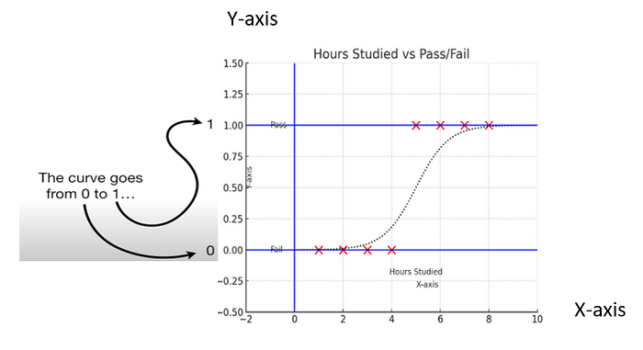
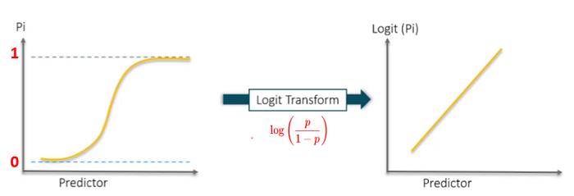
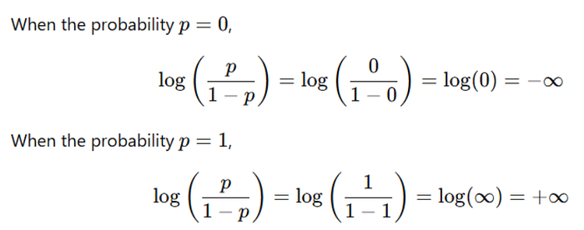
Logistic Regression
P = 0.5 log(p/p-1) = 0
P> 0.5 log(P/P-1) is +ve
P<0.5 log(P/P-1) is -ve

Slide 4
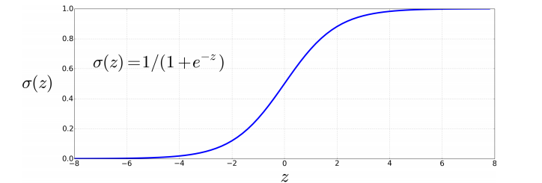

If Z = log (P/P-1) then P/P-1 = exp(Z) P = 1/(1+exp(-Z))
We will assume Z = log (P/P-1) = W₁X₁ + W₂X₂ + W₃X₃ + …………….+ Wn Xn+ b = W.X + b
Where X₁, X₂, X₃, …. Xn are the feature values and W₁, W₂, W₃…..Wn are the weights or coefficients
Z = log(P/P-1)
If z>0 then Ϭ(z) > 0.5
If z <= 0 then Ϭ(z) <= 0.5
Predictors

Slide 5
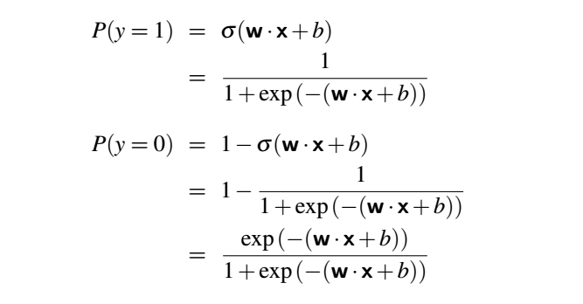
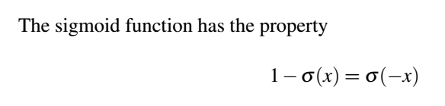
Derivative of Ϭ(z) = Ϭ(z) ( 1- Ϭ(z))

Slide 6
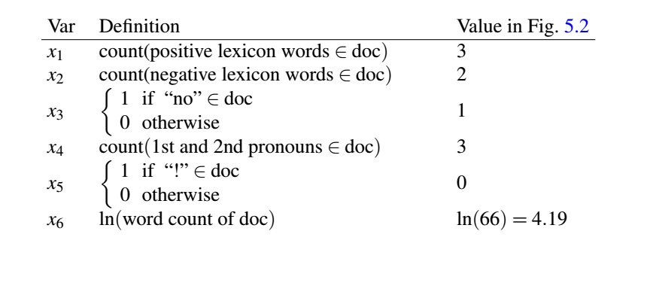
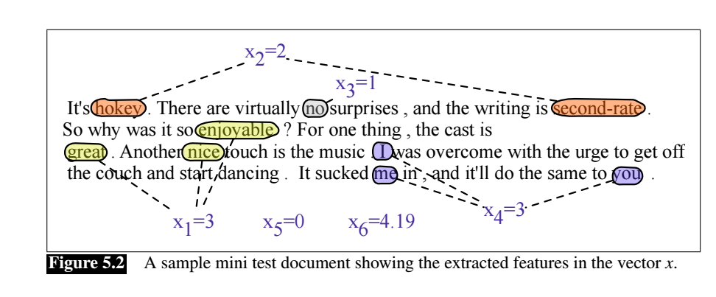

Slide 7
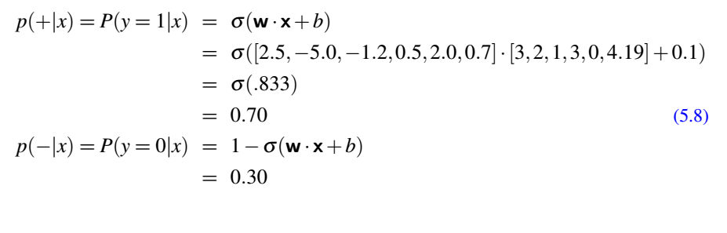
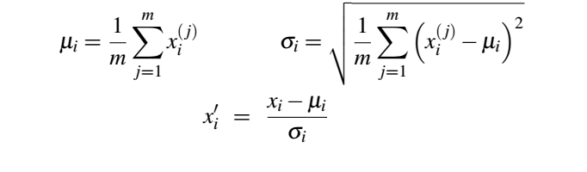
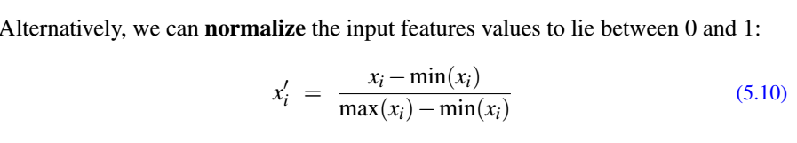
Scaling input features

Slide 8
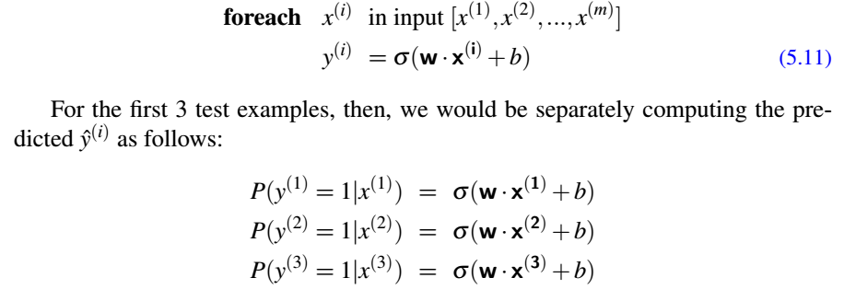
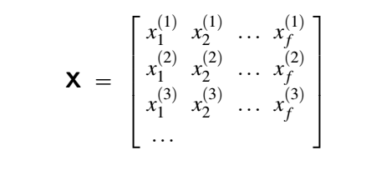
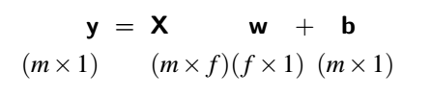
Processing multiple examples in matrix form
Y = Ϭ (XW + b)

Slide 9
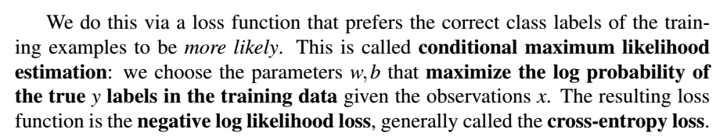

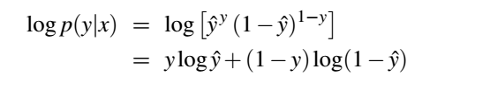
To derive the parameters w1, w2, w3, ……. and b, we will define a Loss function.
We will start with some random values of w1, w2, w3, …… and b and iteratively
update the values using gradient descent until the loss function becomes minimum.
For every example x maximize P(y = 1|x) or P( y = 0 |x)
Maximize
Maximize

Slide 10

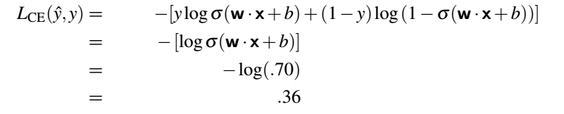
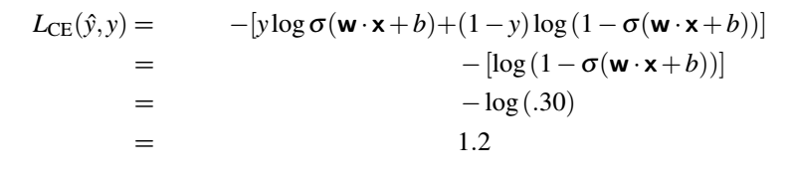

Slide 11



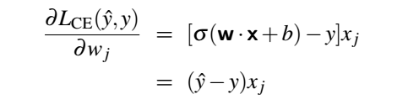
To update any parameter w, we will use gradient descent approach.
We need to take gradient of the Loss function with respect to the parameter w
For z = w1 x1 + w2 x2 + b
w1 = w1 – ղ (ŷ – y) x1
w2 = w2 – ղ (ŷ – y) x2
b = b – ղ (ŷ – y)

Slide 12
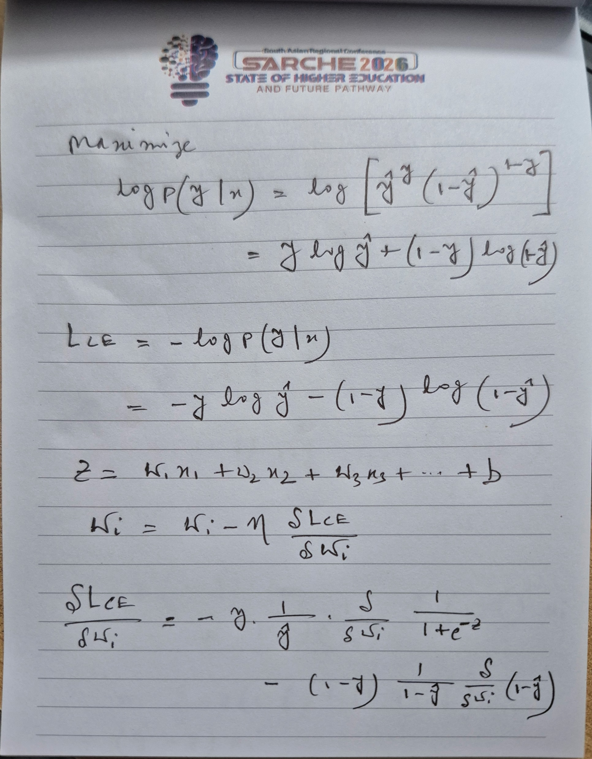
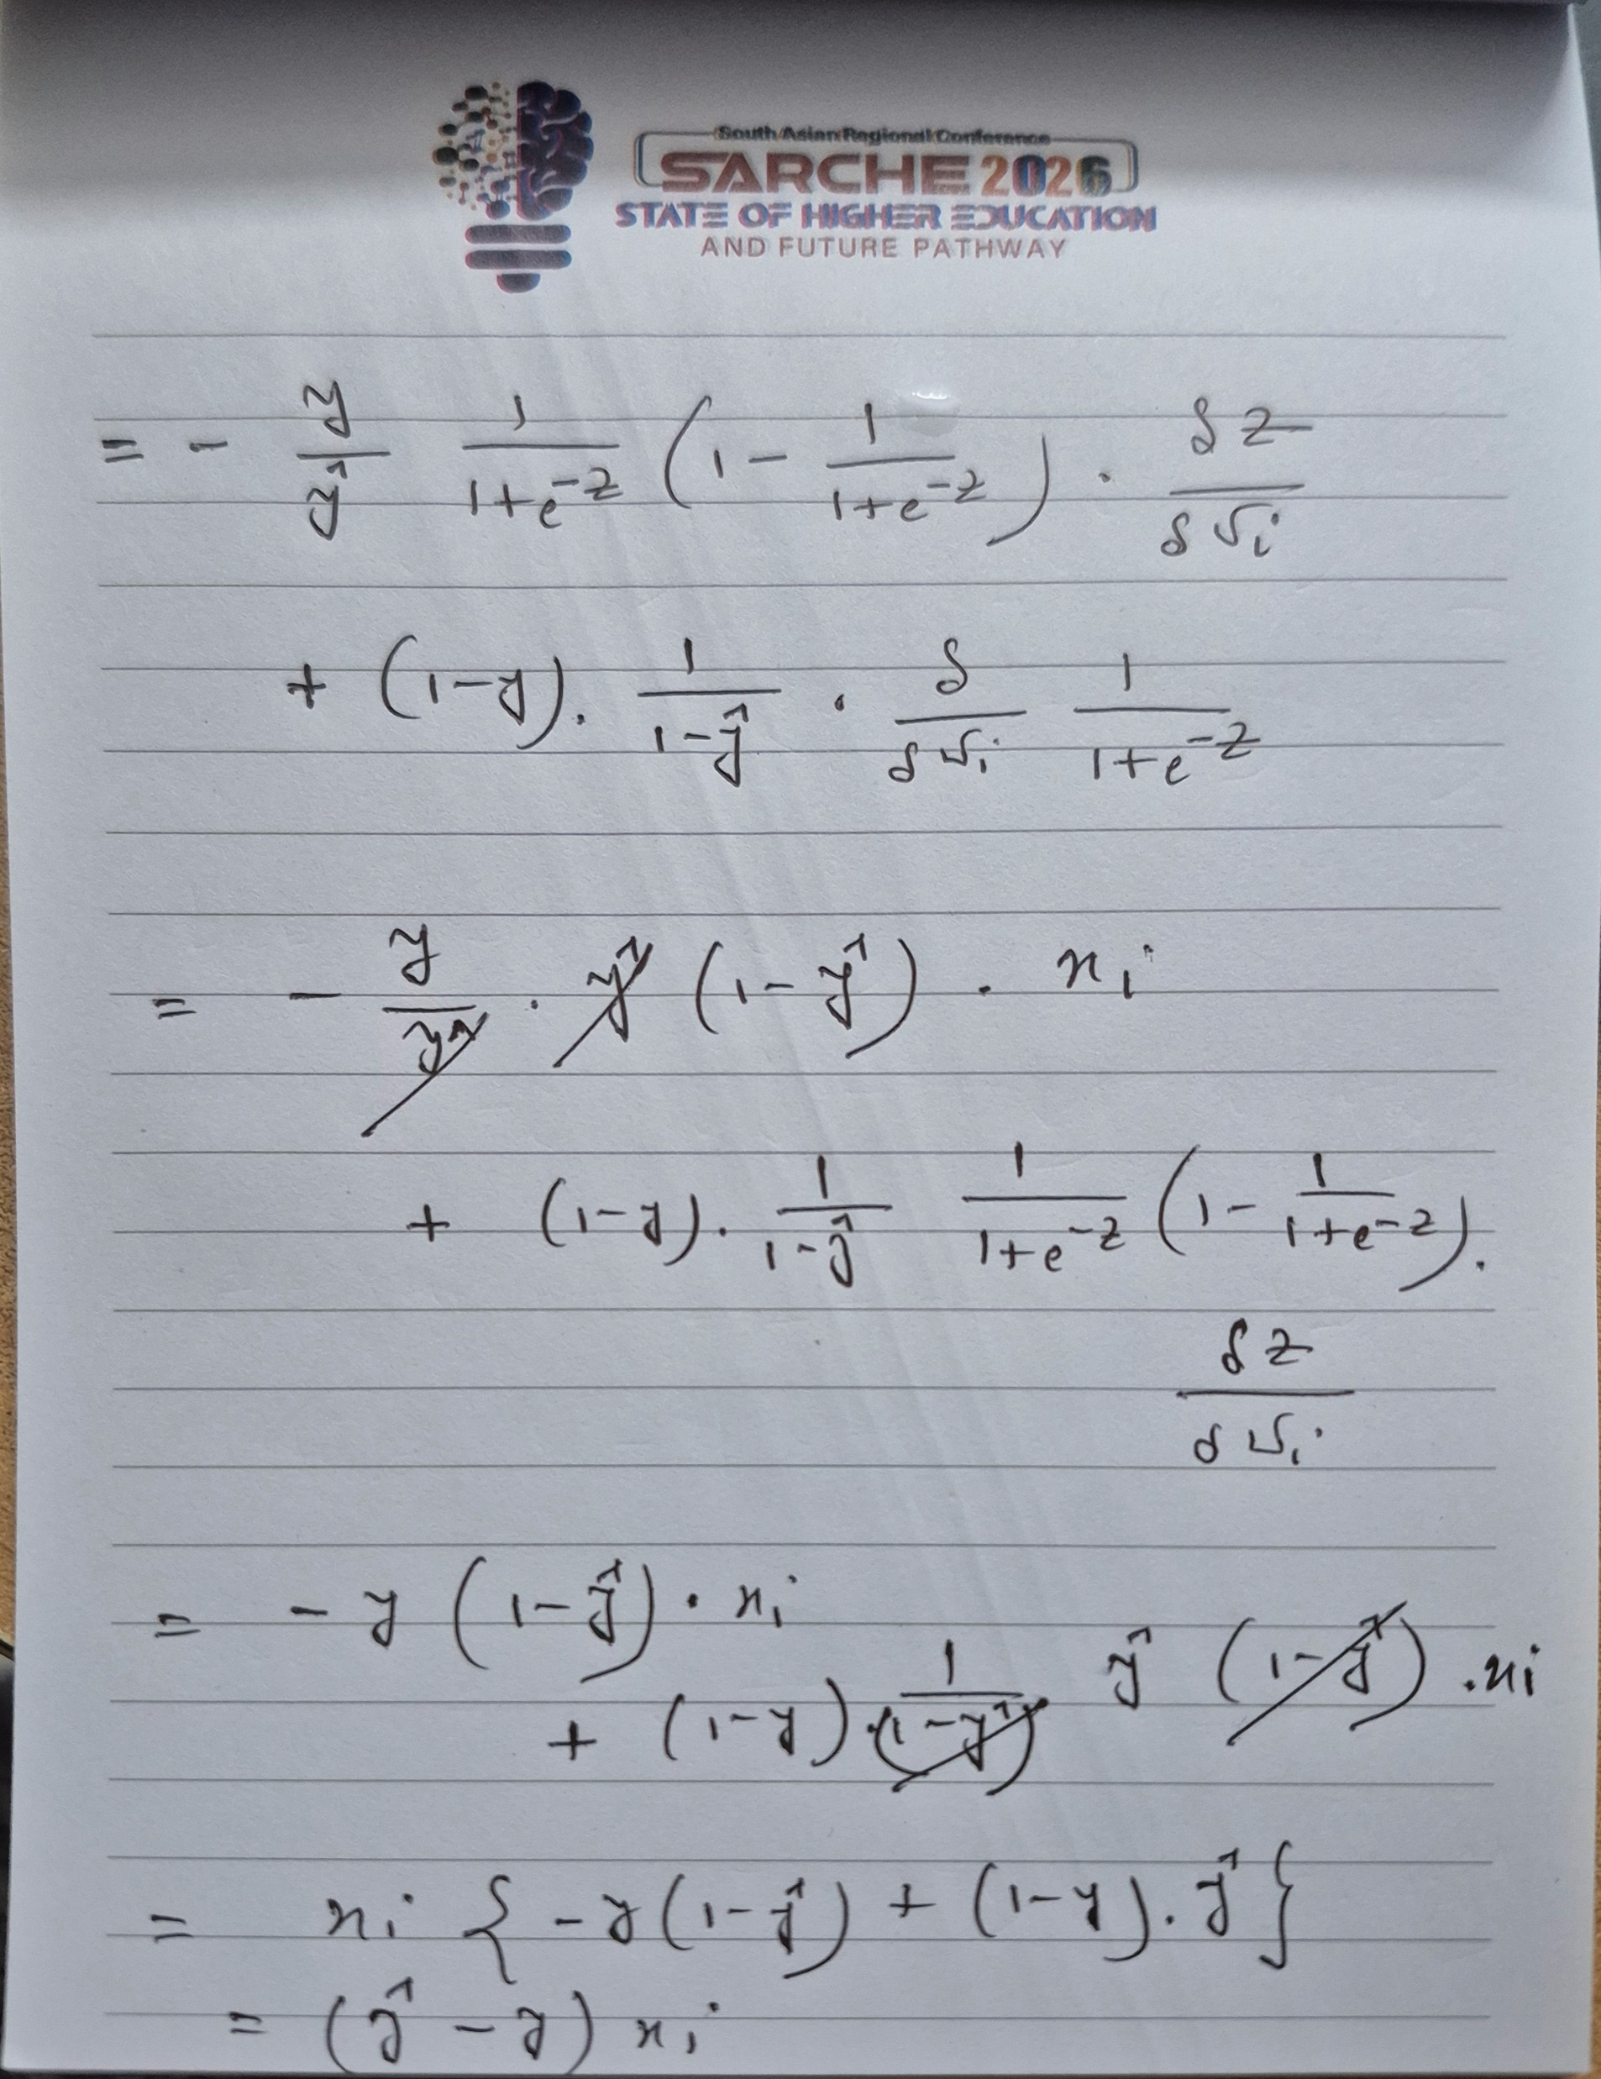

Slide 13
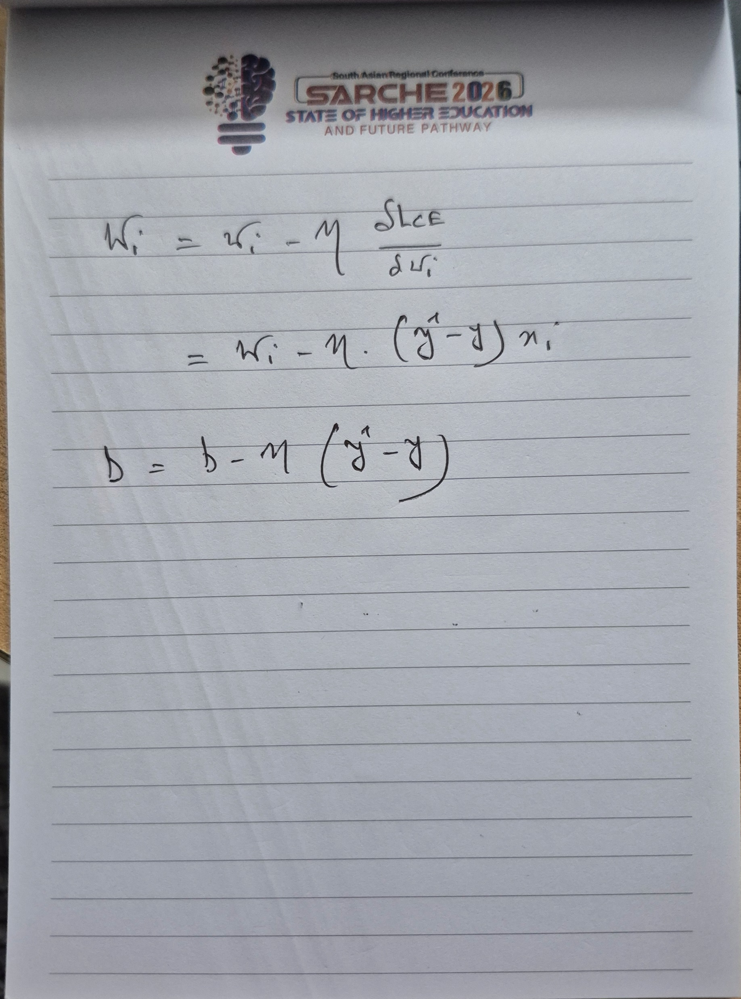

Slide 14
